Slide 1

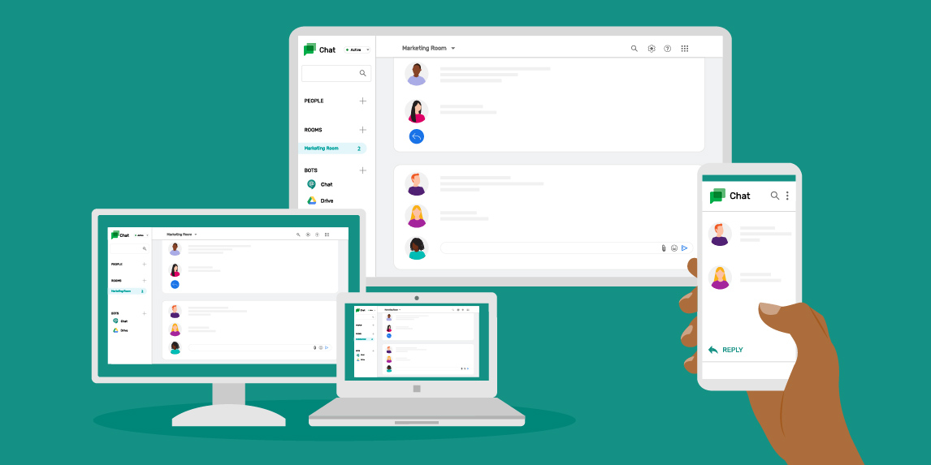
Chat Cyan
Simple Chat Application with an AI

Slide 2





Router

Slide 3





Internet
Router

Slide 4

Internet
Router
Server

Slide 5



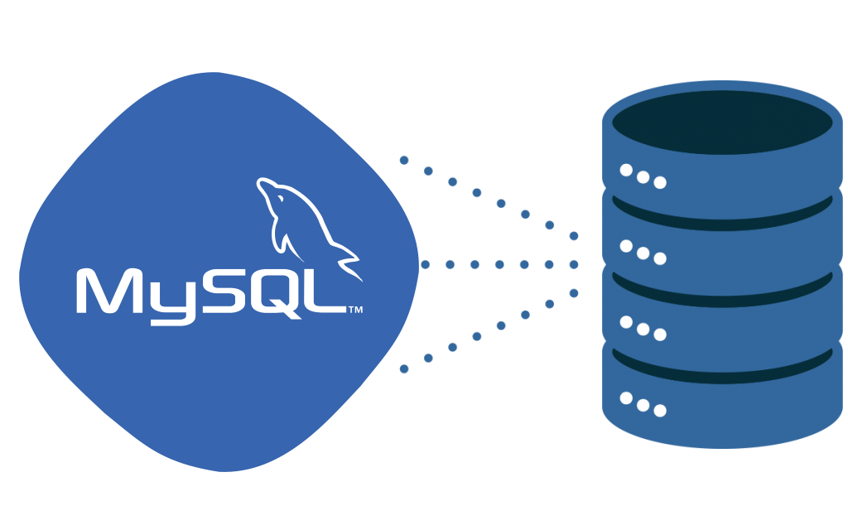
SERVER

Slide 6

My SQL Database

Slide 7
SERVER
My SQL Database
Program Files

Slide 8
SERVER
My SQL Database
Program Files
Images

Slide 9
SERVER
My SQL Database
Images
Other Files To run the Application
Program Files

Slide 10



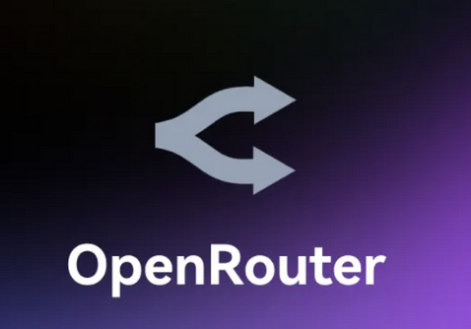
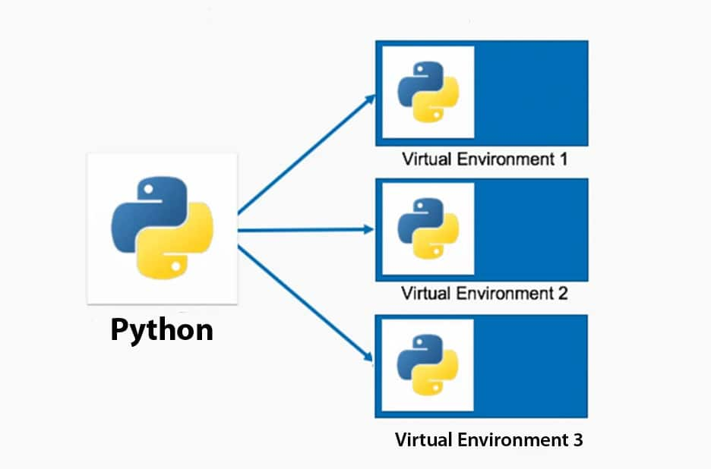
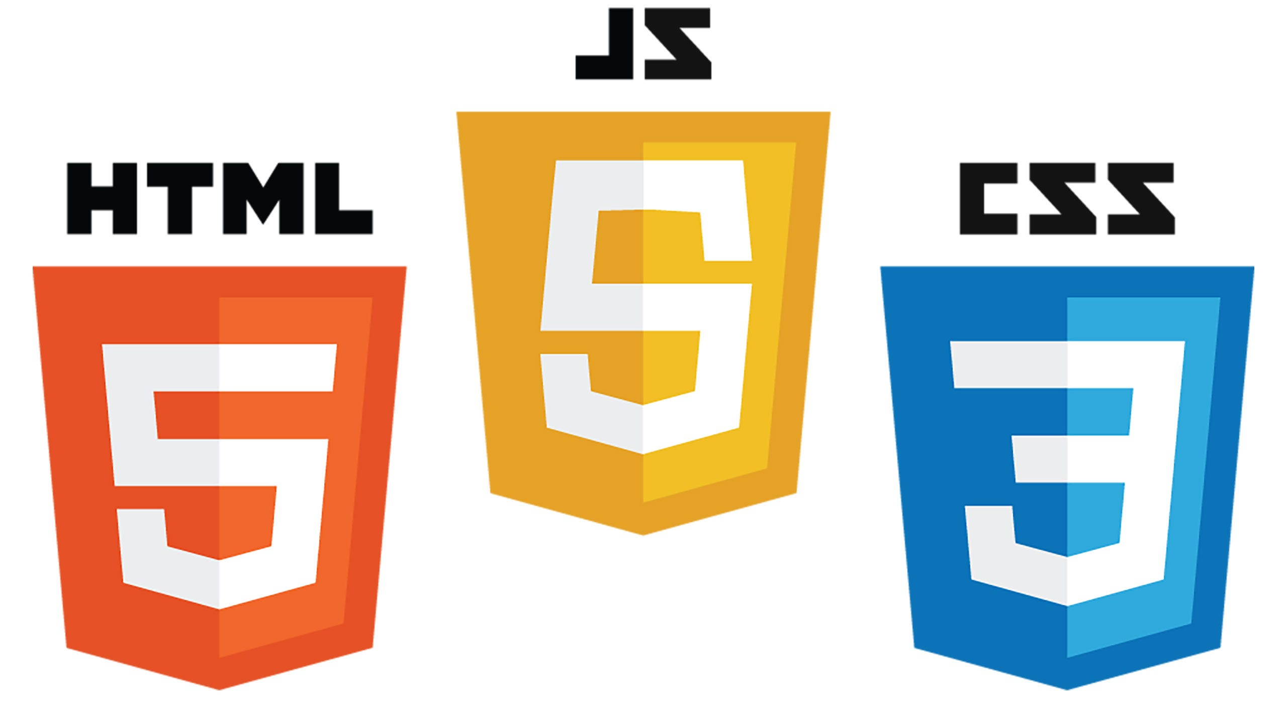

Technologies
Backend
IDE
Version Control
Virtual Environment
Frontend

Slide 11
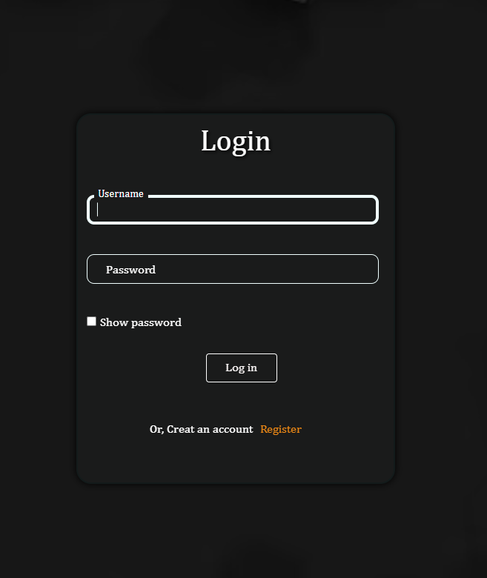
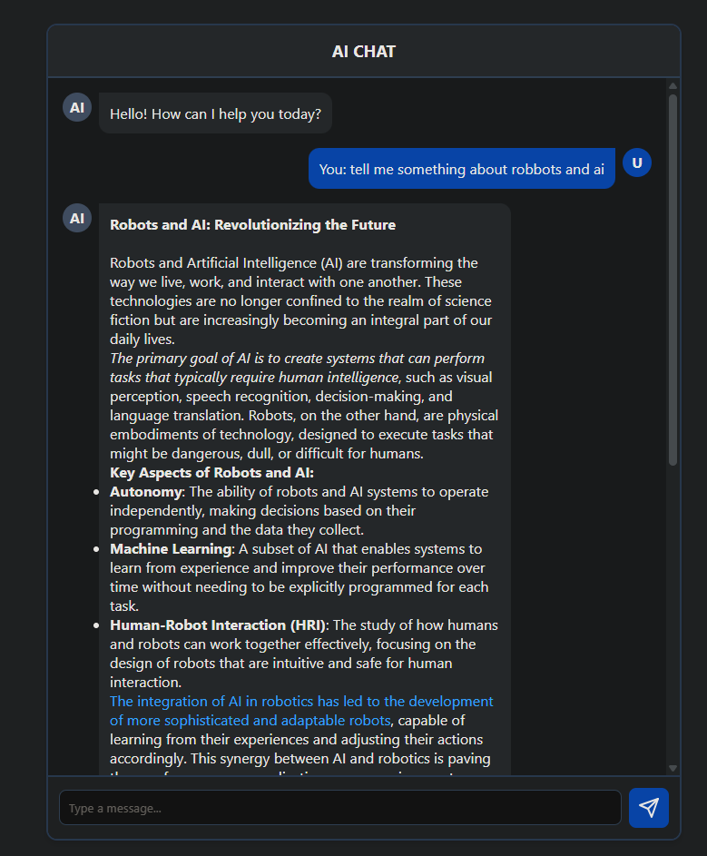
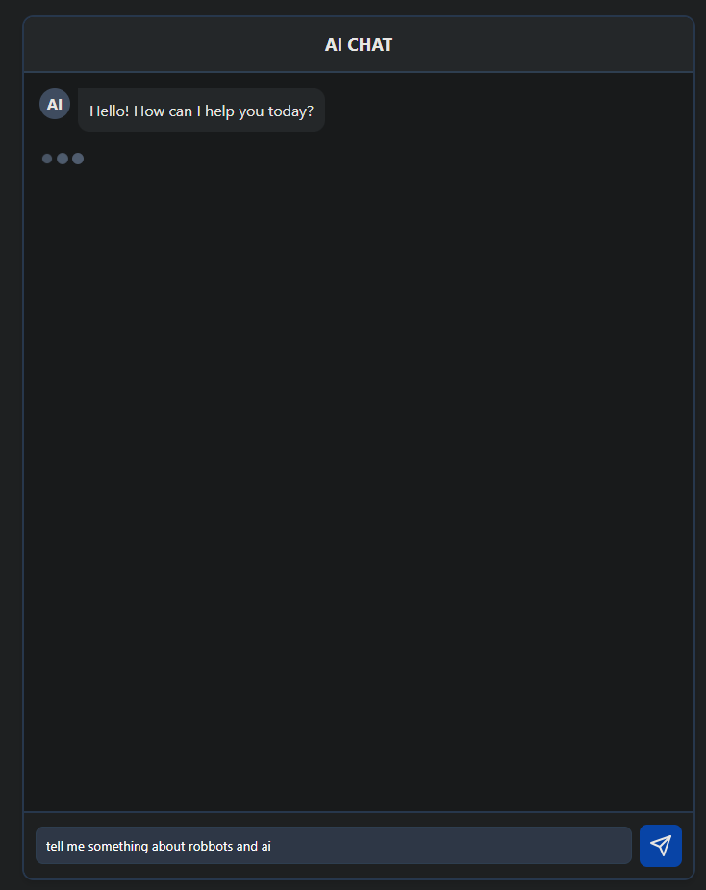
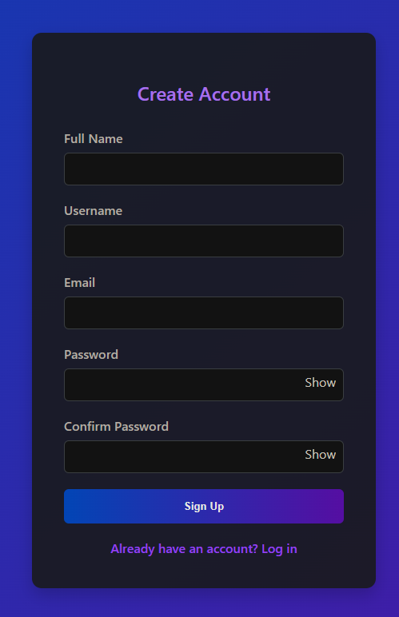
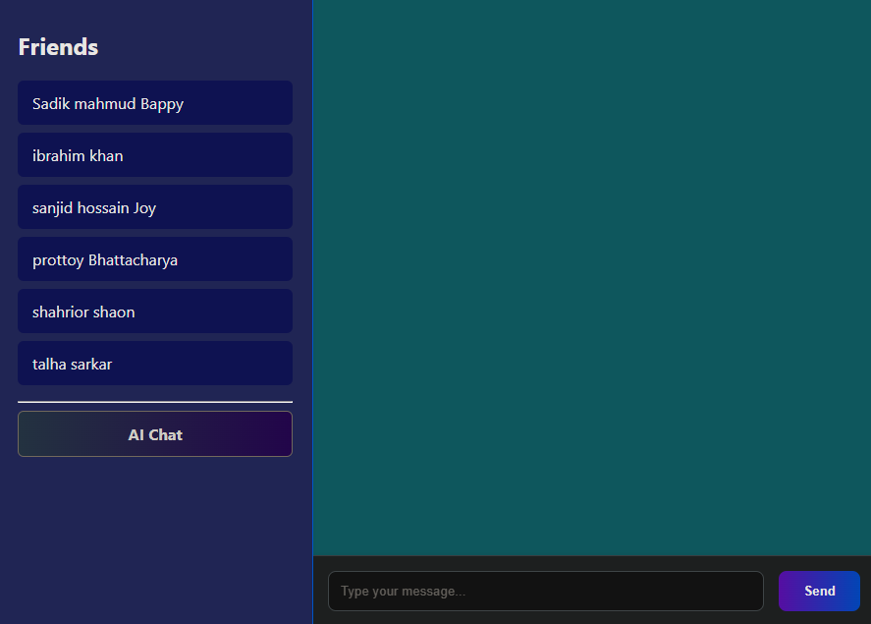
Page designs

Slide 12
Sign up
Page designs

Slide 13
Unique Username
Page designs

Slide 14
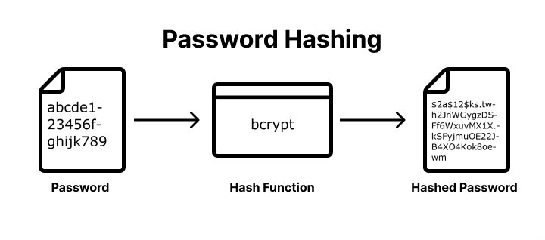

Slide 15
Database

Slide 16

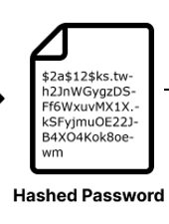

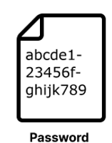
SERVER

Slide 17
SERVER

Slide 18
SERVER

Slide 19
Login

Slide 20
SERVER

Slide 21
Username
SERVER

Slide 22
Username
Password
SERVER

Slide 23
Username
Password
Hash Function
SERVER

Slide 24
Username
Password
Hashed Password
Hash Function
SERVER

Slide 25

Username
Password
Hashed Password
Hash Function
SERVER
Server Hash = Login Hash
Server Hash ≠ Login Hash

Slide 26
Chat Room

Slide 27
SERVER

Slide 28
AI Chat Bot

Slide 29
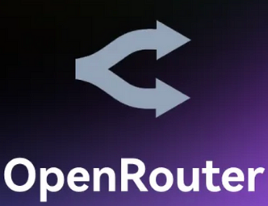

Slide 30
API Key 🗝

Slide 31
API Key 🗝
Response

Slide 32


Slide 33


